Slide 1
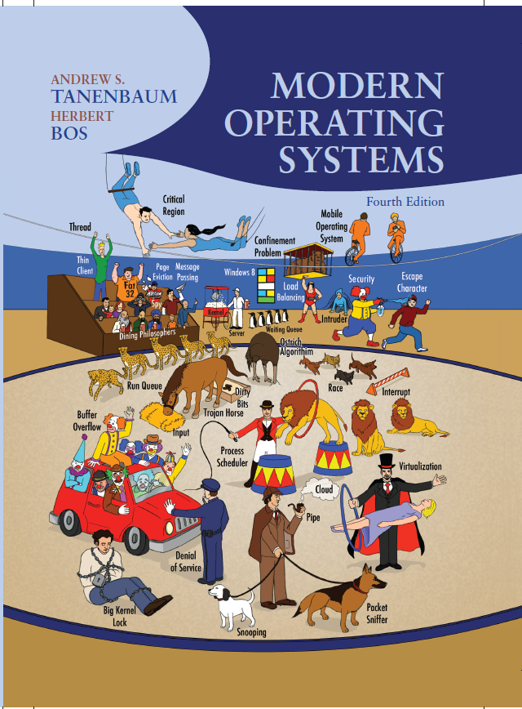
Modern Operating Systems
Fourth Edition
Chapter 3
Memory Management
Copyright © 2014 Pearson Education, Inc. All Rights Reserved
Notes:
If this PowerPoint presentation contains mathematical equations, you may need to check that your computer has the following installed:
1) MathType Plugin
2) Math Player (free versions available)
3) NVDA Reader (free versions available)

Slide 2
Memory
Paraphrase of Parkinson’s Law, ‘‘Programs expand to fill the memory available to hold them.’’
Average home computer nowadays has 10,000 times more memory than the I B M 7094, the largest computer in the world in the early 1960s

Slide 3
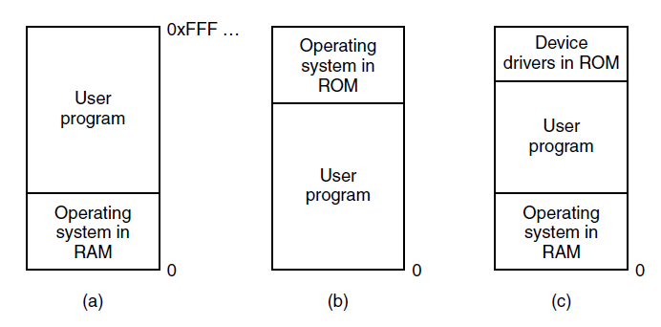
No Memory Abstraction
Figure 3-1. Three simple ways of organizing memory with an operating system and one user process. Other possibilities also exist

Slide 4
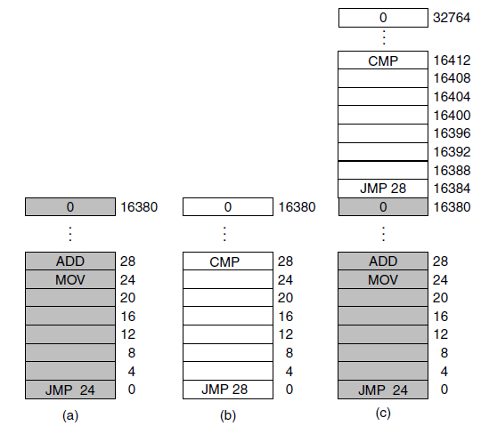
Running Multiple Programs Without a Memory Abstraction
Figure 3-2. Illustration of the relocation problem. (a) A 16-K B program. (b) Another 16-K B program. (c) The two programs loaded consecutively into memory.

Slide 5
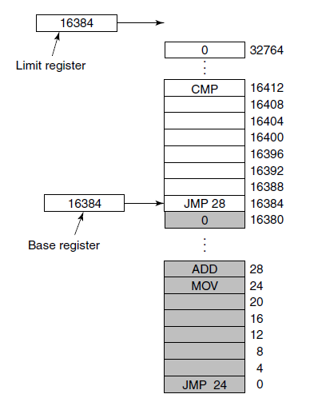
Base and Limit Registers
Figure 3-3. Base and limit registers can be used to give each process a separate address space.

Slide 6
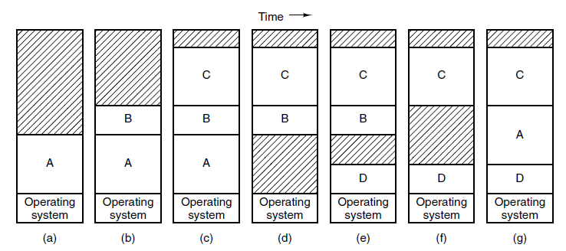
Swapping (1 of 2)
Figure 3-4. Memory allocation changes as processes come into memory and leave it. The shaded regions are unused memory

Slide 7
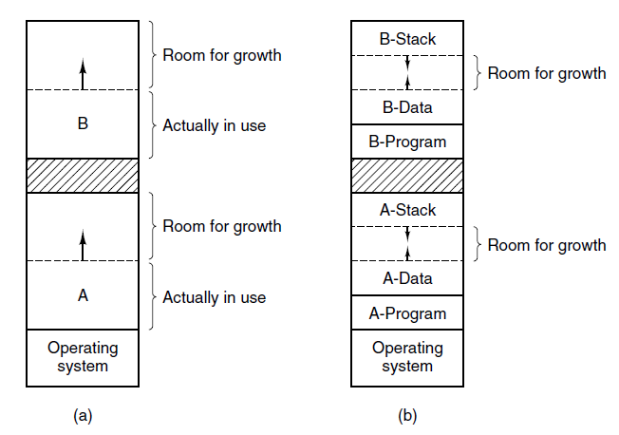
Swapping (2 of 2)
Figure 3-5. (a) Allocating space for a growing data segment. (b) Allocating space for a growing stack and a growing data segment.

Slide 8
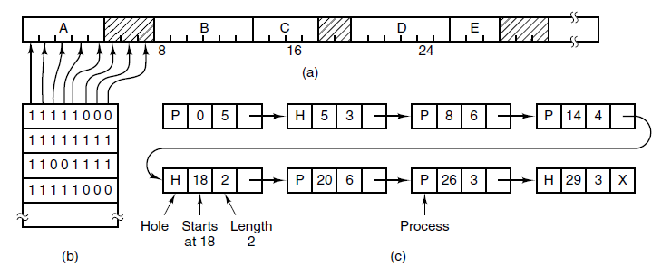
Memory Management with Bitmaps
Figure 3-6. (a) A part of memory with five processes and three holes. The tickmarks show the memory allocation units. The shaded regions (0 in the bitmap) are free. (b) The corresponding bitmap. (c) The same information as a list.

Slide 9
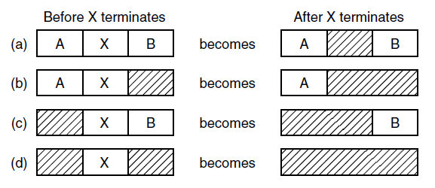
Memory Management with Linked Lists
Figure 3-7. Four neighbor combinations for the terminating process, X.

Slide 10
Memory Management Algorithms
First fit
Next fit
Best fit
Worst fit
Quick fit

Slide 11
Virtual Memory
There is a need to run programs that are too large to fit in memory
Solution adopted in the 1960s, split programs into little pieces, called overlays
Kept on the disk, swapped in and out of memory
Virtual memory : each program has its own address space, broken up into chunks called pages

Slide 12
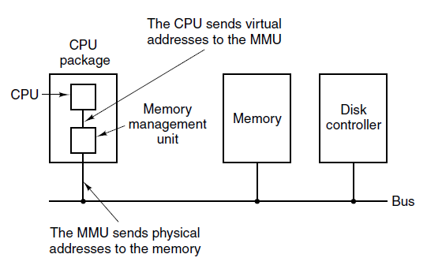
Paging (1 of 3)
Figure 3-8. The position and function of the M M U. Here the M M U is shown as being apart of the C P U chip because it commonly is nowadays. However, logically it could be a separate chip and was years ago.

Slide 13
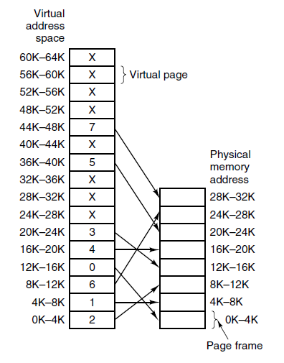
Paging (2 of 3)
Figure 3-9. The relation between virtual addresses and physical memory addresses is given by the page table. Every page begins on a multiple of 4096 and ends 4095 addresses higher, so 4K–8K really means 4096–8191 and 8K to 12K means 8192–12287

Slide 14
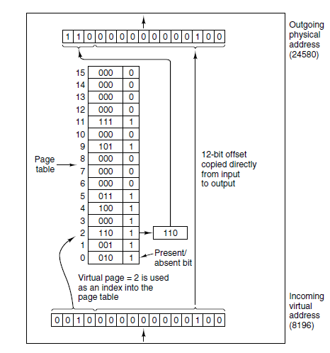
Paging (3 of 3)
Figure 3-10. The internal operation of the M M U with 16 4-KB pages.

Slide 15
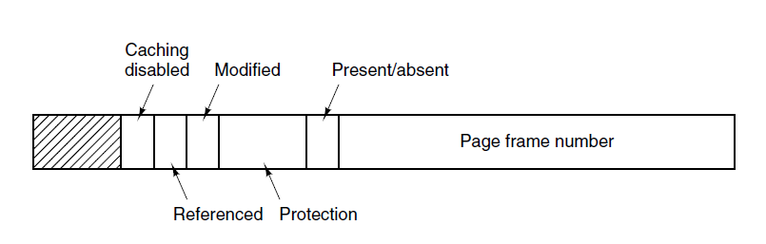
Structure of a Page Table Entry
Figure 3-11. A typical page table entry.

Slide 16
Speeding Up Paging
Major issues faced:
The mapping from virtual address to physical address must be fast.
If the virtual address space is large, the page table will be large.

Slide 17
Translation Lookaside Buffers
A T L B to speed up paging.
Valid | Virtual Page | Modified | Protection | Page Frame
1 | 140 | 1 | RW | 31
1 | 20 | 0 | R X | 38
1 | 130 | 1 | RW | 29
1 | 129 | 1 | RW | 62
1 | 19 | 0 | R X | 50
1 | 21 | 0 | R X | 45
1 | 860 | 1 | RW | 14
1 | 861 | 1 | RW | 75

Slide 18
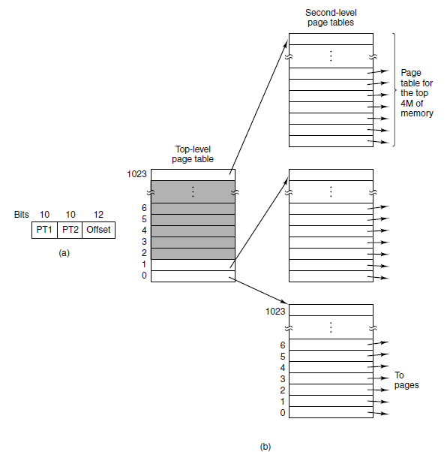
Multilevel Page Tables
Figure 3-13. (a) A 32-bit address with two page table fields. (b) Two-level page tables.

Slide 19
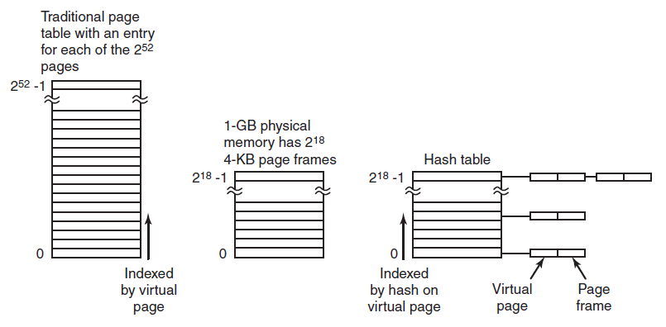
Inverted Page Tables
Figure 3-14. Comparison of a traditional page table with an inverted page table.

Slide 20
Page Replacement Algorithms
Optimal algorithm
Not recently used algorithm
First-in, first-out (F I F O) algorithm
Second-chance algorithm
Clock algorithm
Least recently used (L R U) algorithm
Working set algorithm
W S Clock algorithm

Slide 21
Not Recently Used Algorithm
At page fault, system inspects pages
Categories of pages based on the current values of their R and M bits:
Class 0: not referenced, not modified.
Class 1: not referenced, modified.
Class 2: referenced, not modified.
Class 3: referenced, modified.

Slide 22
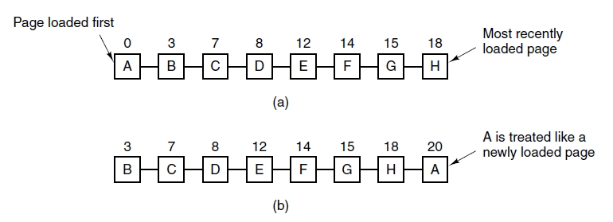
Second-Chance Algorithm
Figure 3-15. Operation of second chance. (a) Pages sorted in F I F O order. (b) Page list if a page fault occurs at time 20 and A has its R bit set. The numbers above the pages are their load times.

Slide 23
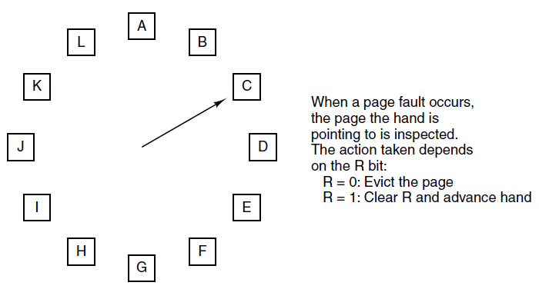
Clock Page Replacement Algorithm
Figure 3-16. The clock page replacement algorithm.

Slide 24
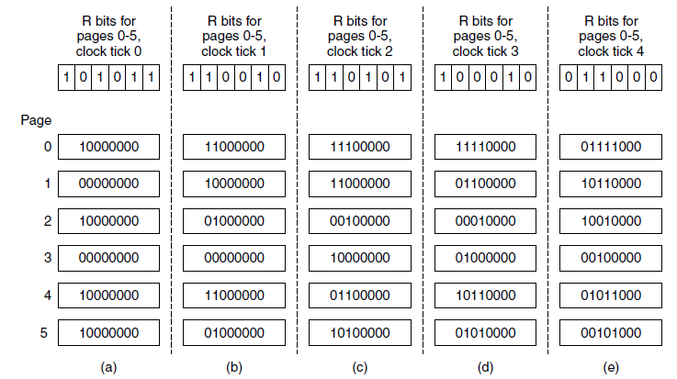
Simulating L R U in Software
Figure 3-17. The aging algorithm simulates L R U in software. Shown are six pages for five clock ticks. The five clock ticks are represented by (a) to (e).

Slide 25
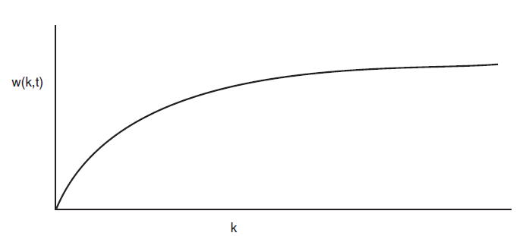
Working Set Algorithm (1 of 2)
Figure 3-18. The working set is the set of pages used by the k most recent memory references. The function w(k, t) is the size of the working set at time t.

Slide 26
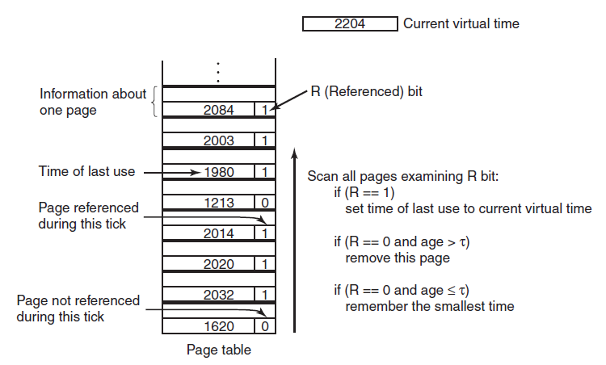
Working Set Algorithm (2 of 2)
Figure 3-19. The working set algorithm.

Slide 27
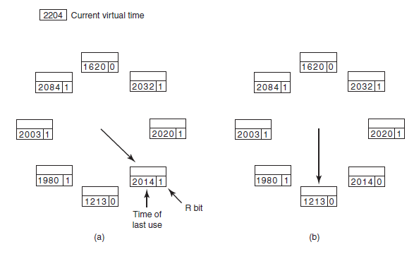
W S Clock Algorithm (1 of 2)
Figure 3-20. Operation of the W S Clock algorithm. (a) and (b) give an example of what happens when R = 1.

Slide 28
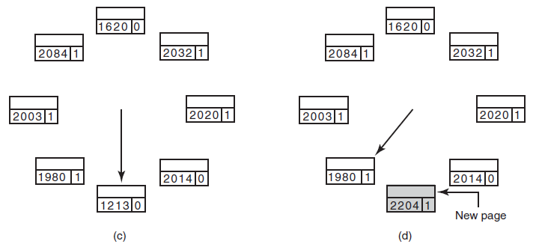
W S Clock Algorithm (2 of 2)
Figure 3-20. Operation of the W S Clock algorithm. (c) and (d) give an example of R = 0.

Slide 29
Summary of Page Replacement Algorithms
Page replacement algorithms discussed in the text.
Algorithm | Comment
Optimal | Not implementable, but useful as a benchmark
N R U (Not Recently Used) | Very crude approximation of L R U
F I F O (First-in, First-out) | Might throw out important pages
Second, chance | Big improvement over F I F O
Clock | Realistic
L R U (Least Recently Used) | Excellent, but difficult to implement exactly
N F U (Not Frequently Used) | Fairly crude approximation to L R U
Aging | Efficient algorithm that approximates L R U well
Working set | Somewhat expensive to implement
W S Clock | Good efficient algorithm

Slide 30
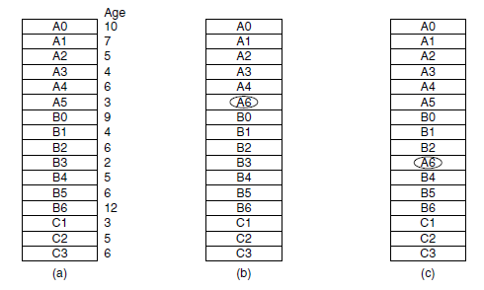
Local versus Global Allocation Policies (1 of 2)
Figure 3-22. Local versus global page replacement. (a) Original configuration. (b) Local page replacement. (c) Global page replacement.

Slide 31
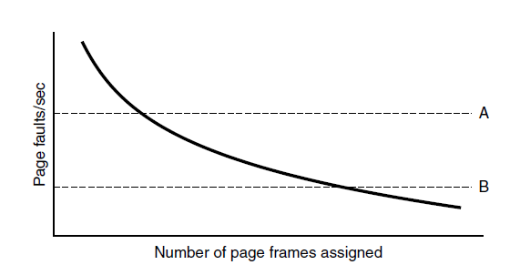
Local versus Global Allocation Policies (2 of 2)
Figure 3-23. Page fault rate as a function of the number of page frames assigned.

Slide 32
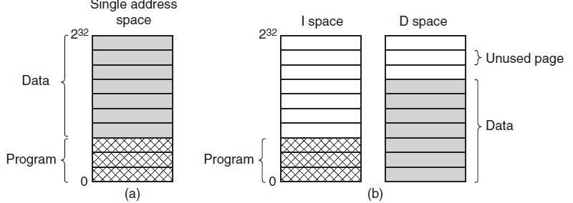
Separate Instruction and Data Spaces
Figure 3-24. (a) One address space. (b) Separate I and D spaces.

Slide 33
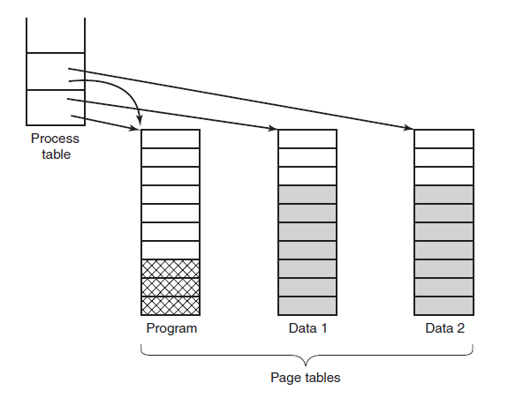
Shared Pages
Figure 3-25. Two processes sharing the same program sharing its page table.

Slide 34
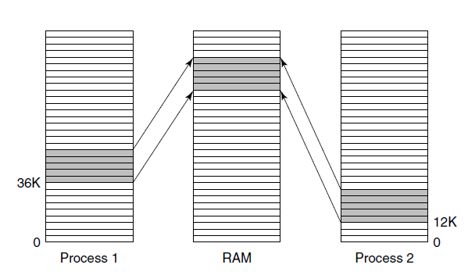
Shared Libraries
Figure 3-26. A shared library being used by two processes.

Slide 35
Page Fault Handling (1 of 3)
The hardware traps to kernel, saving program counter on stack.
Assembly code routine started to save general registers and other volatile info
system discovers page fault has occurred, tries to discover which virtual page needed
Once virtual address caused fault is known, system checks to see if address valid and the protection consistent with access

Slide 36
Page Fault Handling (2 of 3)
If frame selected dirty, page is scheduled for transfer to disk, context switch takes place, suspending faulting process
As soon as frame clean, operating system looks up disk address where needed page is, schedules disk operation to bring it in.
When disk interrupt indicates page has arrived, tables updated to reflect position, and frame marked as being in normal state.

Slide 37
Page Fault Handling (3 of 3)
Faulting instruction backed up to state it had when it began and program counter is reset
Faulting process is scheduled, operating system returns to routine that called it.
Routine reloads registers and other state information, returns to user space to continue execution

Slide 38
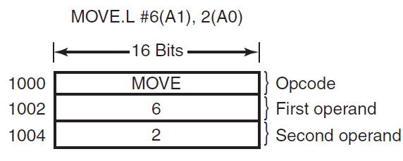
Instruction Backup
Figure 3-27. An instruction causing a page fault.

Slide 39
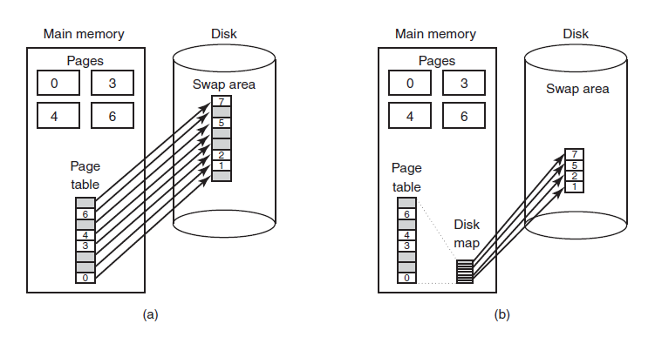
Backing Store
Figure 3-28. (a) Paging to a static swap area. (b) Backing up pages dynamically.

Slide 40
Separation of Policy and Mechanism (1 of 2)
Memory management system is divided into three parts
A low-level M M U handler.
A page fault handler that is part of the kernel.
An external pager running in user space.

Slide 41
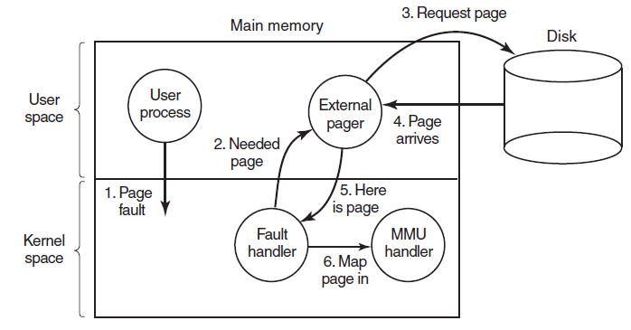
Separation of Policy and Mechanism (2 of 2)
Figure 3-29. Page fault handling with an external pager.

Slide 42
Segmentation (1 of 4)
Examples of tables generated by compiler:
The source text being saved for the printed listing
The symbol table, names and attributes of variables.
The table containing integer and floating-point constants used.
The parse tree, syntactic analysis of the program.
The stack used for procedure calls within compiler.

Slide 43
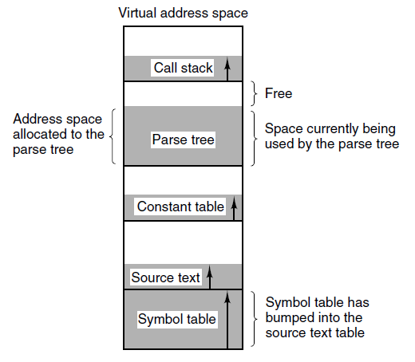
Segmentation (2 of 4)
Figure 3-30. In a one-dimensional address space with growing tables, one table may bump into another.

Slide 44
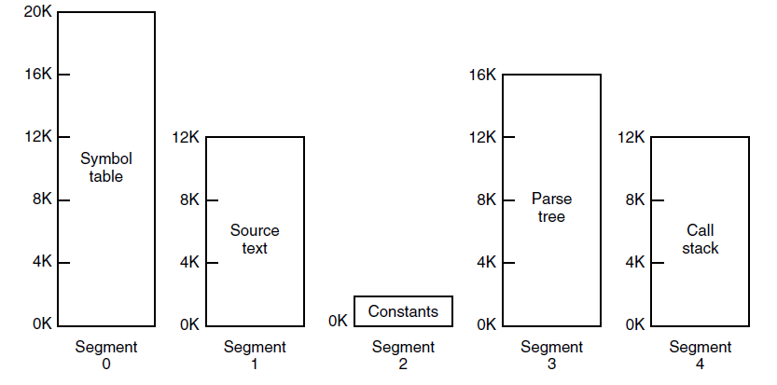
Segmentation (3 of 4)
Figure 3-31. A segmented memory allows each table to grow or shrink independently of the other tables.

Slide 45
Segmentation (4 of 4)
Comparison of paging and segmentation
Consideration | Paging | Segmentation
Need the programmer be aware that this technique is being used? | No | Yes
How many linear address spaces are there? | 1 | Many
Can the total address space exceed the size of physical memory? | Yes | Yes
Can procedures and data be distinguished and separately protected? | No | Yes
Can tables whose size fluctuates be accommodated easily? | No | Yes
Is sharing of procedures between users facilitated? | No | Yes
Why was this technique invented? | To get a large linear address space without having to buy more physical memory | To allow programs and data to be broken up into logically independent address spaces and to aid sharing and protection

Slide 46
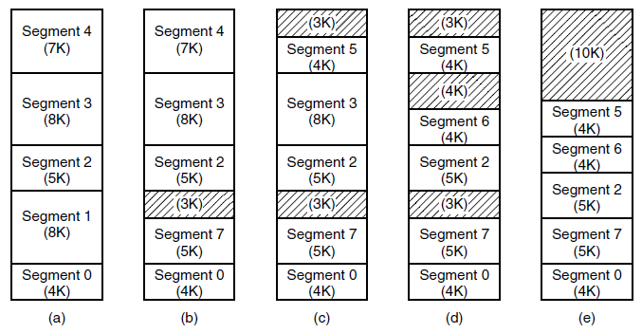
Implementation of Pure Segmentation
Figure 3-33. (a)-(d) Development of checkerboarding. (e) Removal of the checkerboarding by compaction.

Slide 47
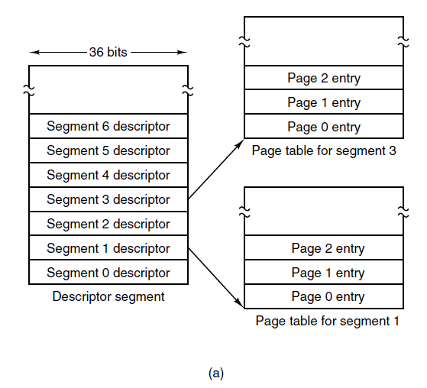
Segmentation with Paging: M U L T I C S (1 of 5)
Figure 3-34. The M U L T I C S virtual memory. (a) The descriptor segment pointed to the page tables.

Slide 48
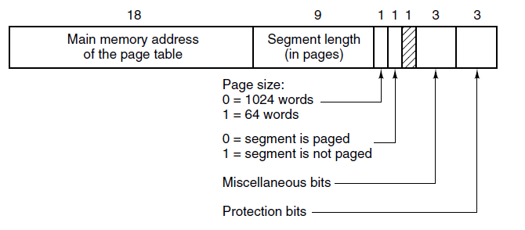
Segmentation with Paging: M U L T I C S (2 of 5)
Figure 3-34. The M U L T I C S virtual memory. (b) A segment descriptor. The numbers are the field lengths.

Slide 49
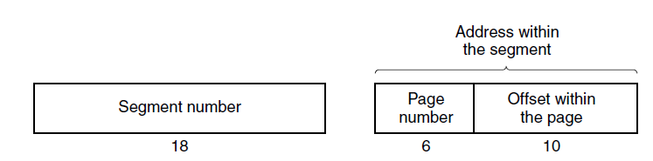
Segmentation with Paging: M U L T I C S (3 of 5)
Figure 3-35. A 34-bit M U L T I C S virtual address.

Slide 50
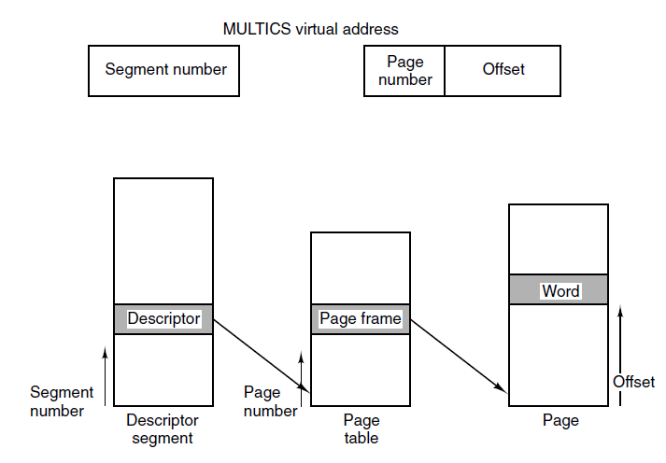
Segmentation with Paging: M U L T I C S (4 of 5)
Figure 3-36. Conversion of a two-part M U L T I C S address into a main memory address.

Slide 51
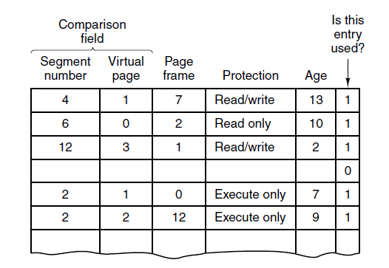
Segmentation with Paging: M U L T I C S (5 of 5)
Figure 3-37. A simplified version of the M U L T I C S T L B. The existence of two page sizes made the actual T L B more complicated.

Slide 52
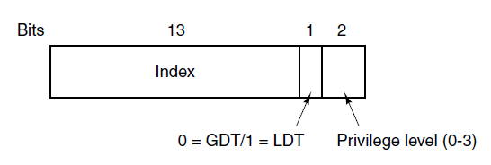
Segmentation with Paging: The Intel x86 (1 of 4)
Figure 3-38. An x86 selector.

Slide 53
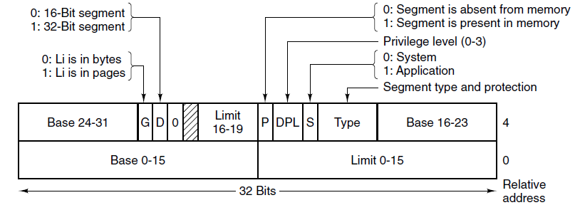
Segmentation with Paging: The Intel x86 (2 of 4)
Figure 3-39. x86 code segment descriptor. Data segments differ slightly.

Slide 54
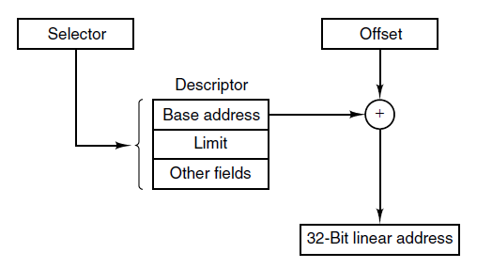
Segmentation with Paging: The Intel x86 (3 of 4)
Figure 3-40. Conversion of a (selector, offset) pair to a linear address.

Slide 55
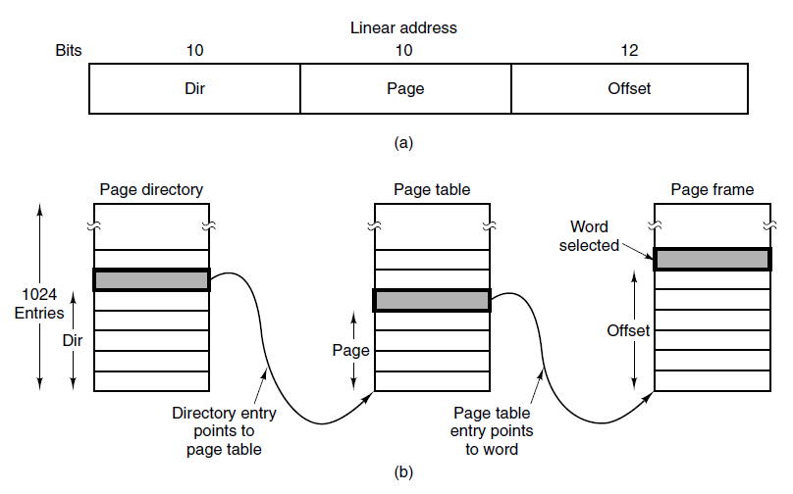
Segmentation with Paging: The Intel x86 (4 of 4)
Figure 3-41. Mapping of a linear address onto a physical address.

Slide 56

Copyright

